Slide 1
Stream Ciphers Striving for Randomness
Carl Schünemann (Chapter 1-2)
Simon Thalmaier (Chapter 3-4)
Larysa Bondar (Chapter 5-7)

Slide 2
“Any one who considers arithmetical methods of producing random digits is, of course, in a state of sin.”
John von Neumann, summarized by George E. Forsythe, 1951 [2, p. 36]

Slide 3
Stream Ciphers: Striving for randomness
Presentation Overview
The Idea of Stream Ciphers
Linear Feedback Shift Registers
Security of Stream Ciphers Based on LFSRs
Increasing the Cryptographic Qualities of LFSRs
The eSTREAM Contest
Trivium
Conclusion

Slide 4
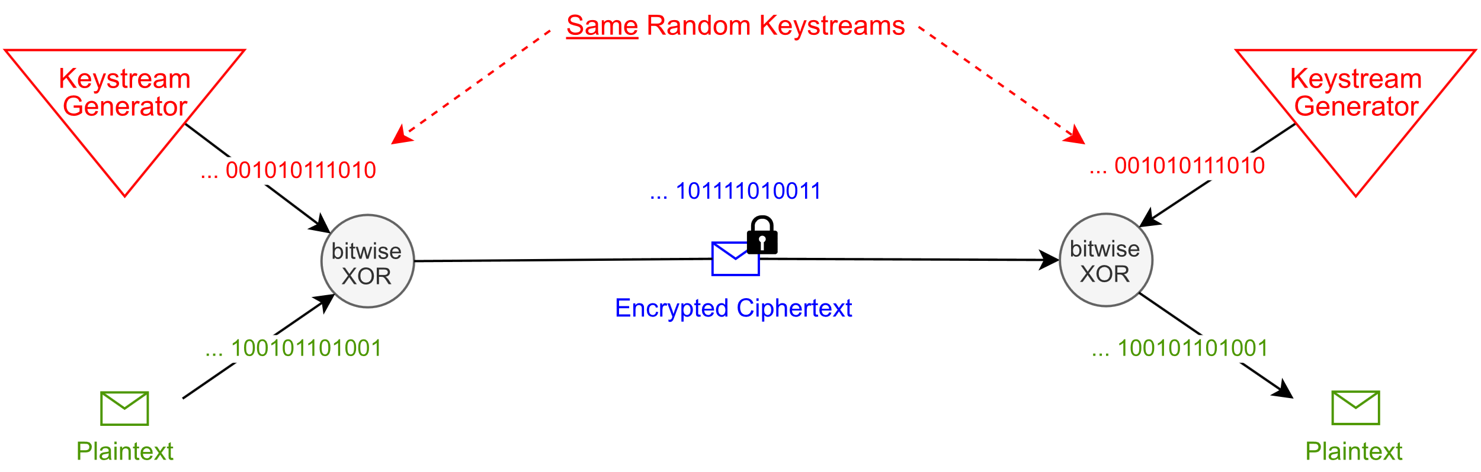
The Idea of Stream Ciphers
Stream Cipher: A Symmetric Cipher
How can random keystreams be generated?
How can two identical keystreams be generated?
Based on: [4, p. 232]

Slide 5
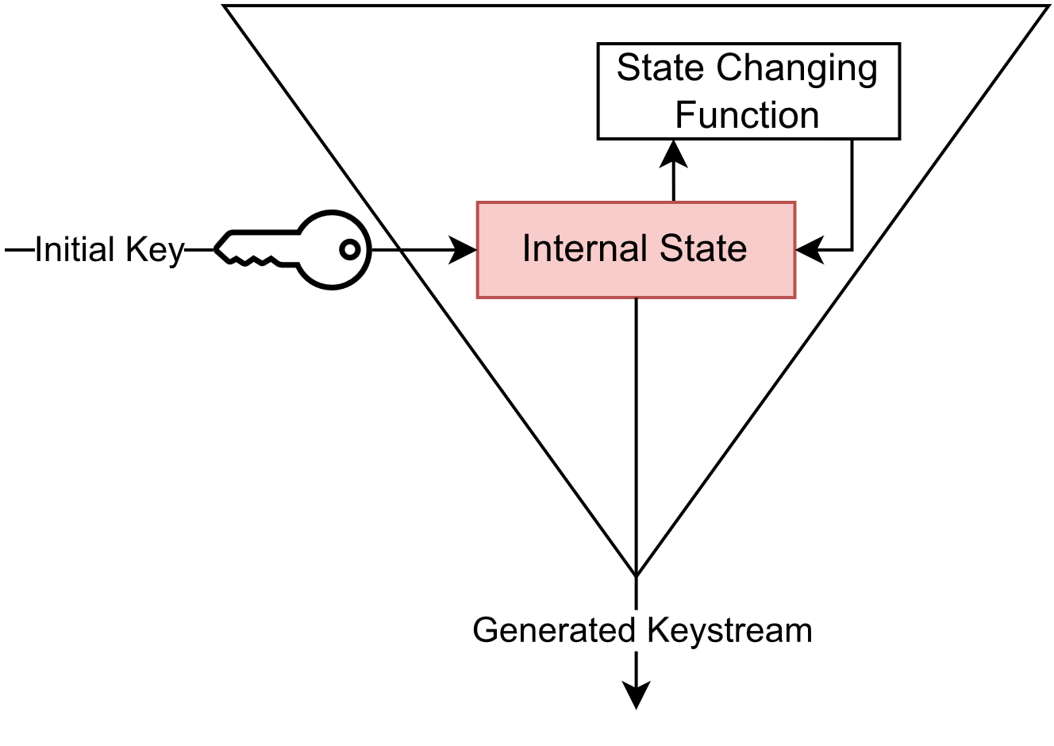
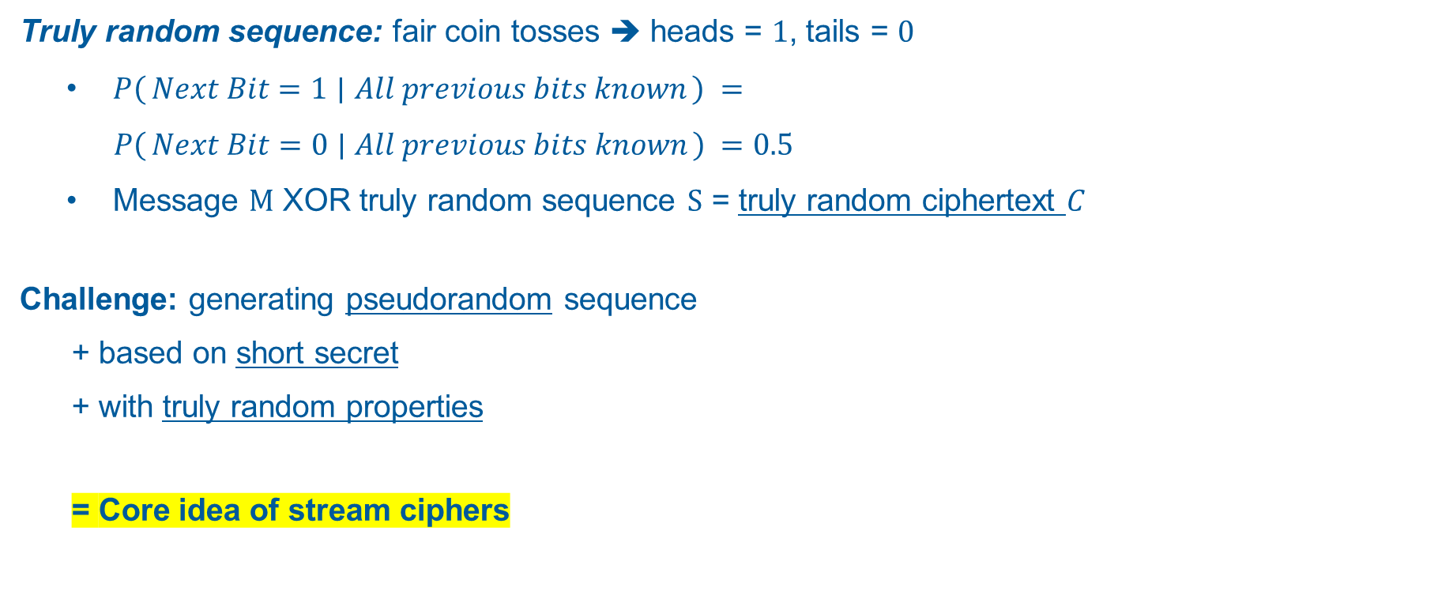
The Idea of Stream Ciphers
Pseudorandomness: Generating Randomness
Truly random sequence: fair coin tosses ➔ heads = $1$, tails = $0$
$P\left(Next Bit=1 ∣ All previous bits known\right)$ $=$
$P\left(Next Bit=0 ∣ All previous bits known\right) =0.5$
Message $M$ XOR truly random sequence $S$ = truly random ciphertext $C$
Challenge: generating pseudorandom sequence
+ based on short secret
+ with truly random properties
= Core idea of stream ciphers
Based on: [4, p. 234]

Slide 6
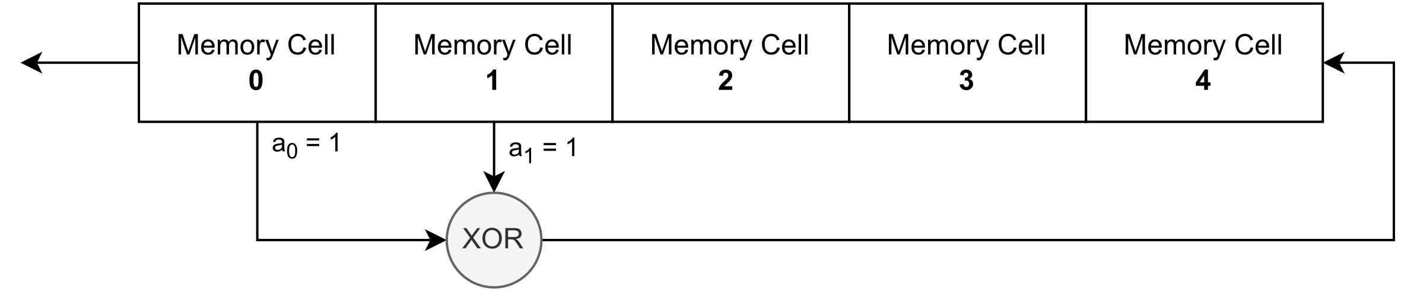

Linear Feedback Shift Registers (LFSRs)
Popular tool for stream ciphers: $\sim 80$ years of research history
Reason for popularity: mathematical interpretability
Tapped Cells
Based on: [4, p. 430]
Feedback Function

Slide 7
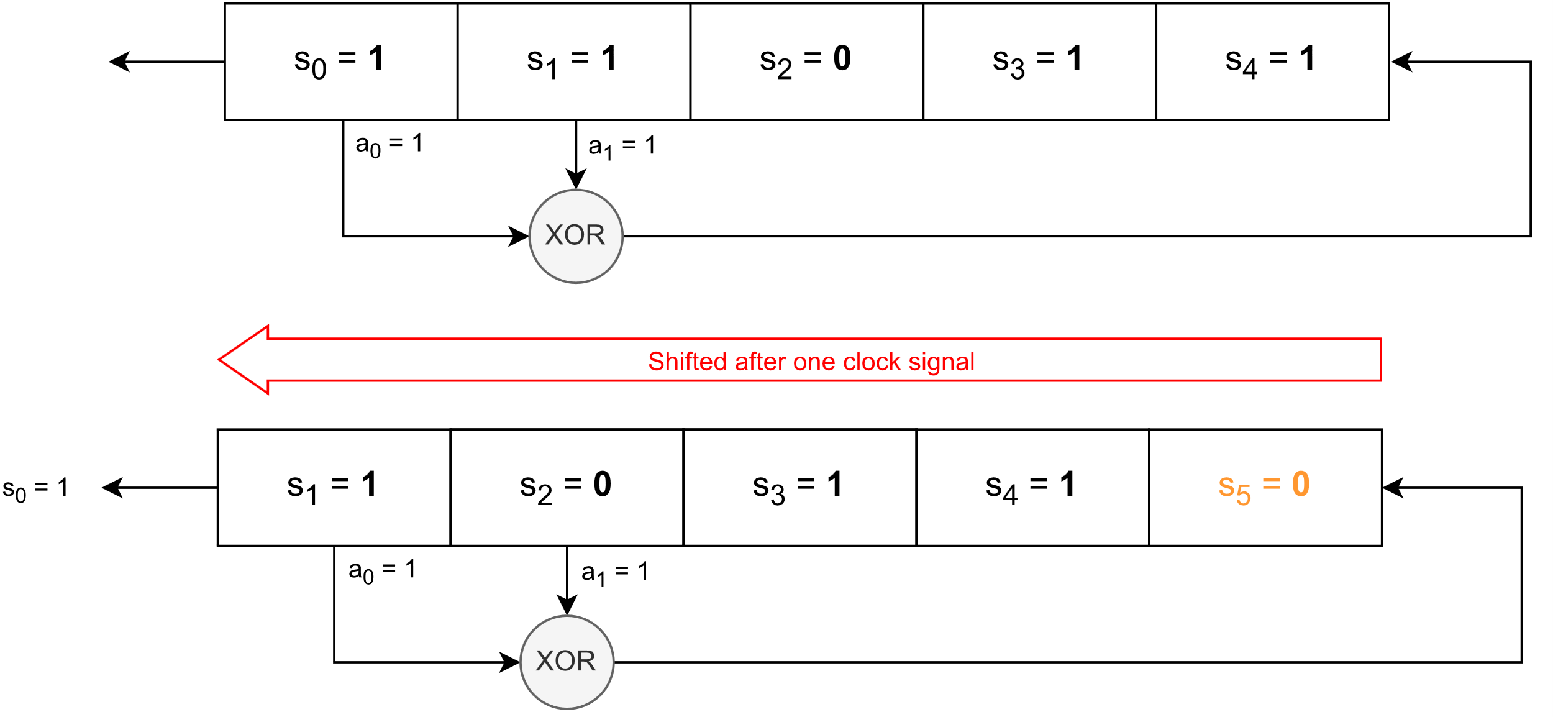

Linear Feedback Shift Registers (LFSRs)
Generating Pseudorandom Numbers with LFSRs
Bit $s_{n+k}$calculated by feedback function after $n$-th shift:
$s_{0}$, $s_{1}$, …, $s_{k−1}$ := initial state and $a$₀, $a$₁, …, $a_{k−1}$ := tapped memory cells
Example k = 5
$s_{5}$= ${a\text{0}s}_{0}+{a1s}_{1}=1+1=0 ($ℤ/2ℤ)
$s_{n+k}=a_{k−1}s_{n+k−1}+a_{k−2}s_{n+k−2}+ … +a_{0}s_{n}$ with ${s_{i},a}_{i}$∈ IF₂ (≙ ℤ/2ℤ)

Slide 8
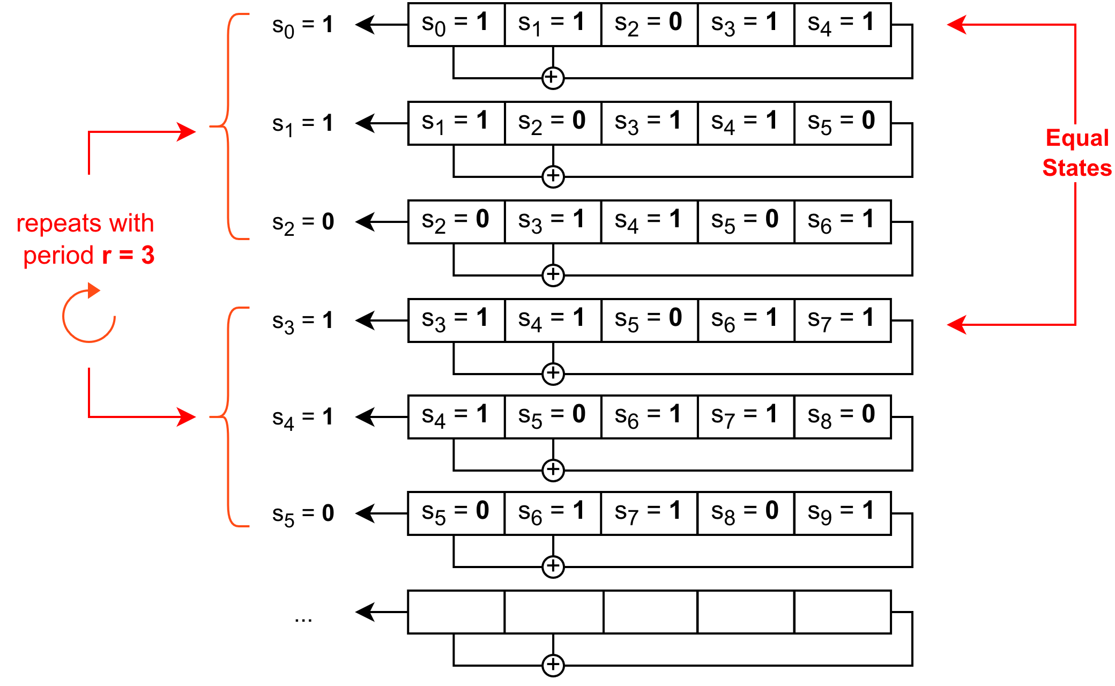

Linear Feedback Shift Registers (LFSRs)
Generating Pseudorandom Numbers with LFSRs
Bit $s_{n+k}$calculated by feedback function after $n$-th shift:
$s_{0}$, $s_{1}$, …, $s_{k−1}$ := initial state and $a$₀, $a$₁, …, $a_{k−1}$ := tapped memory cells
Period $r$:
$s_{n+r}=s_{n}$for all $n≥n_{0}$ with $r{, n}_{0}∈ℕ$
Maximum possible period $r=2^{k}−1$
Period can depend on initial state s₀, s₁, …, s_{k-1}
$s_{n+k}=a_{k−1}s_{n+k−1}+a_{k−2}s_{n+k−2}+ … +a_{0}s_{n}$ with ${s_{i},a}_{i}$∈ IF₂ (≙ ℤ/2ℤ)

Slide 9


Linear Feedback Shift Registers (LFSRs)
Optimizing LFSRs: m-sequences
Desired: maximum period + independent of initial state ➔ m-sequences
Producing m-sequences:
Describing the LFSR as matrix A ∈ IF₂^{k×k} :
Characteristic polynomial of A :
→ LFSR produces m-sequence, if characteristic polynomial of A is primitive
$$\left(\begin{matrix}0 & 0 & 0 & … & 0 & a_{0} \\ 1 & 0 & 0 & … & 0 & a_{1} \\ 0 & 1 & 0 & … & 0 & a_{2} \\ ⋮ & ⋮ & ⋮ & & ⋮ & ⋮ \\ 0 & 0 & 0 & … & 1 & a_{k−1}\end{matrix}\right)$$
with $a_{i}$:= tapped variables
$$f\left(x\right)=det\left(xI−A\right)= x^{k}+a_{k−1}x^{k−1}+a_{k−2}x^{k−2}+…+ a_{0}∈{\text{IF}}_{2} \left[x\right]$$

Slide 10
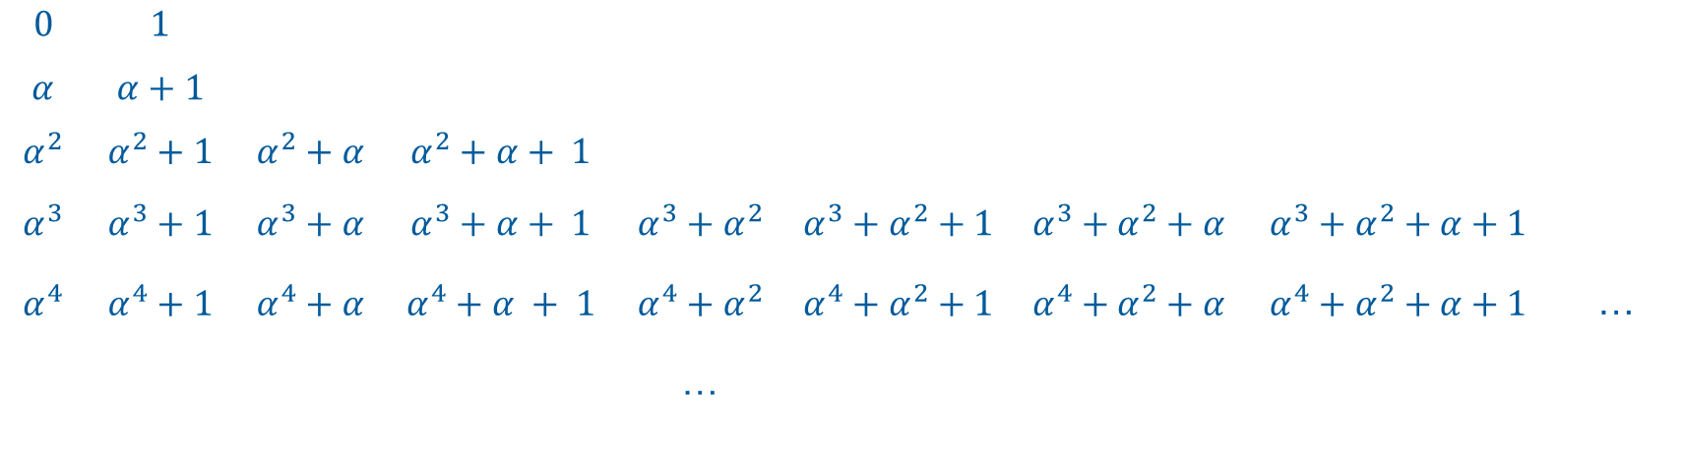

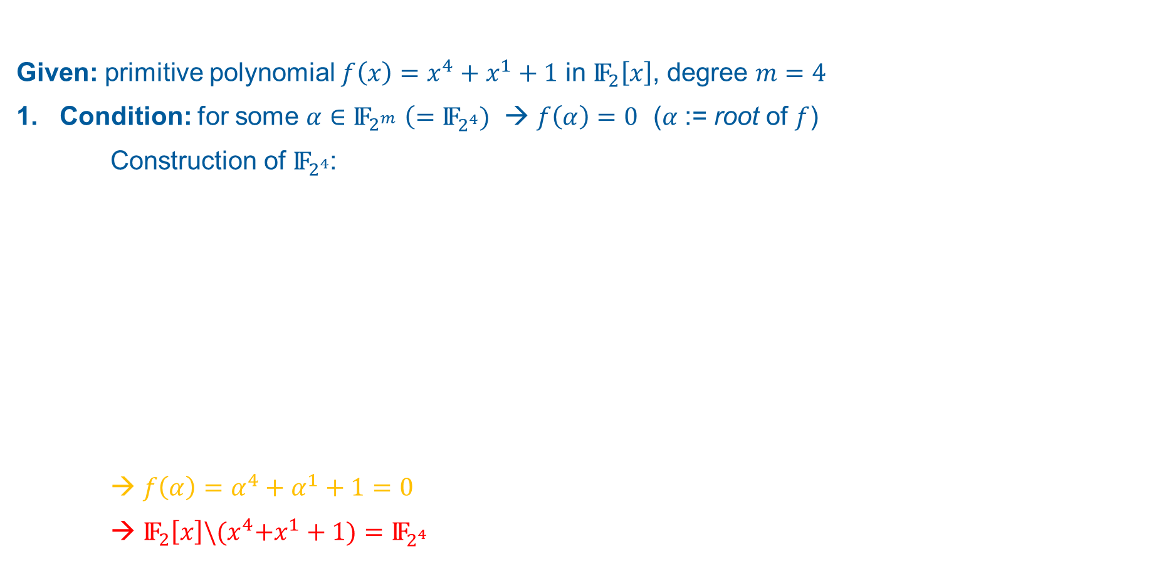



Linear Feedback Shift Registers (LFSRs)
m-sequences: Primitive Polynomials
Given: primitive polynomial $f\left.\left(x\right.\right)=x^{4}+x^{1}+1$ in ${\text{IF}}_{2}\left[x\right]$, degree $m=4$
1. Condition: for some $\text{α}∈{\text{IF}}_{2^{m}}$ $\left(={\text{IF}}_{2^{4}})\right.$ → $f\left.\left(α\right.\right)=0$ (𝛼 := root of $f$)
Construction of ${\text{IF}}_{2^{4}}$:
→ $f\left.\left(α\right.\right)={\text{α}}^{4}+{\text{α}}^{1}+1=0$
→ ${\text{IF}}_{2}\left[x\right]\backslash {(x}^{4}+x^{1}+1)={\text{IF}}_{2^{4}}$
$$0$$ | $$1$$
$$\text{α}$$ | $$\text{α}+1$$
$${\text{α}}^{2}$$ | $${\text{α}}^{2}+1$$ | $${\text{α}}^{2}+\text{α}$$ | $${\text{α}}^{2}+\text{α}+ 1$$
$${\text{α}}^{3}$$ | $${\text{α}}^{3}+1$$ | $${\text{α}}^{3}+\text{α}$$ | $${\text{α}}^{3}+\text{α}+ 1$$ | $${\text{α}}^{3}+{\text{α}}^{2}$$ | $${\text{α}}^{3}+{\text{α}}^{2}+1$$ |  | $${\text{α}}^{3}+{\text{α}}^{2}+\text{α}$$ | $${\text{α}}^{3}+{\text{α}}^{2}+\text{α}+1$$
$${\text{α}}^{4}$$ | $${\text{α}}^{4}+1$$ | $${\text{α}}^{4}+\text{α}$$ | $${\text{α}}^{4}+\text{α} + 1$$ | $${\text{α}}^{4}+{\text{α}}^{2}$$ | $${\text{α}}^{4}+{\text{α}}^{2}+1$$ |  | $${\text{α}}^{4}+{\text{α}}^{2}+\text{α}$$ | $${\text{α}}^{4}+{\text{α}}^{2}+\text{α}+1$$ | …
 |  |  |  | …
$${\text{IF}}_{2^{4}}$$
$${\text{IF}}_{2}\left[x\right]$$
$${\text{α}}^{4}+\text{α} + 1$$
$$"=0 "$$
$$=0+{\text{α}}^{2}={\text{α}}^{2}$$

Slide 11
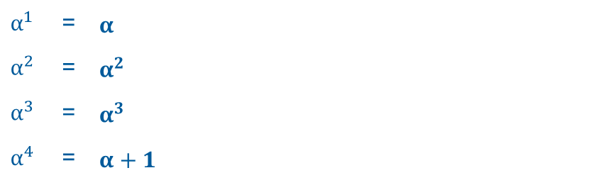
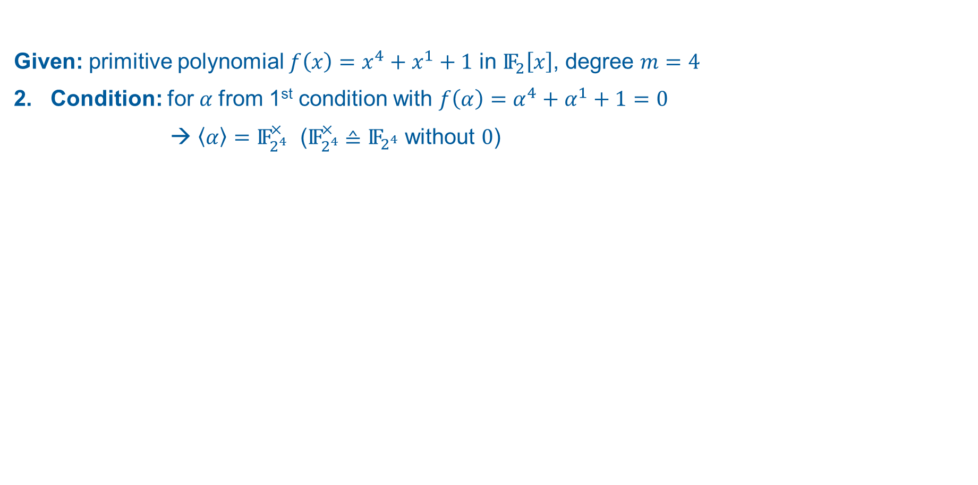
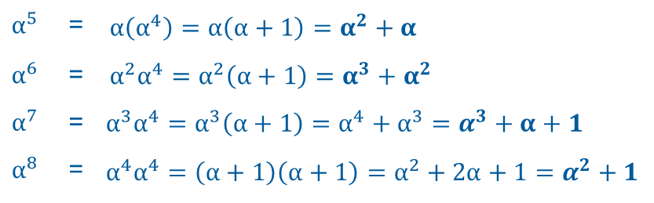
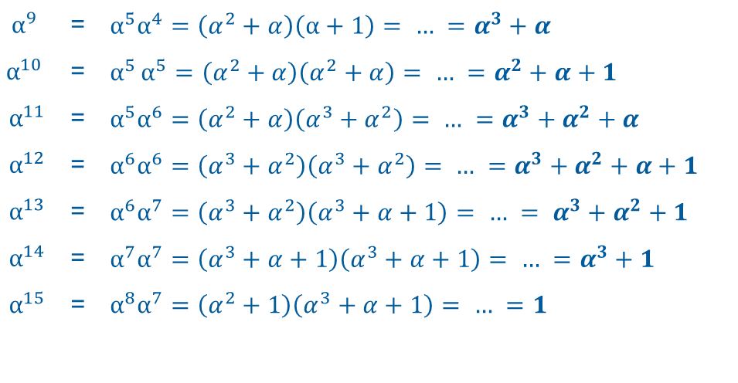
Linear Feedback Shift Registers (LFSRs)
m-sequences: Primitive Polynomials
Given: primitive polynomial $f\left.\left(x\right.\right)=x^{4}+x^{1}+1$ in ${\text{IF}}_{2}\left[x\right]$, degree $m=4$
2. Condition: for 𝛼 from 1st condition with $f\left.\left(α\right.\right)={\text{α}}^{4}+{\text{α}}^{1}+1=0$
→ $\left.\left\langle α\right.\right\rangle ={\text{IF}}_{2^{4}}^{×}$ (${\text{IF}}_{2^{4}}^{×}$ ≙ ${\text{IF}}_{2^{4}}$ without $0$)
$$α^{1}$$ | = | $$α$$
$$α^{2}$$ | = | $$α^{2}$$
$$α^{3}$$ | = | $$α^{3}$$
$$α^{4}$$ | = | $α+1$
$$α^{9}$$ | = | $$α^{5}\left.α^{4}\right.=\left(α^{2}+α\right)\left(α+1\right)= … =α^{3}+α$$
$$α^{10}$$ | = | $$α^{5}\left.α^{5}\right.=\left(α^{2}+α\right)\left(α^{2}+α\right)= … =α^{2}+α+1$$
$$α^{11}$$ | = | $$α^{5}\left.α^{6}\right.=\left(α^{2}+α\right)\left(α^{3}+α^{2}\right)= … =α^{3}+α^{2}+α$$
$$α^{12}$$ | = | $$α^{6}\left.α^{6}\right.=\left(α^{3}+α^{2}\right)\left(α^{3}+α^{2}\right)= … =α^{3}+α^{2}+α+1$$
$$α^{13}$$ | = | $$α^{6}\left.α^{7}\right.=\left(α^{3}+α^{2}\right)\left(α^{3}+α+1\right)= … = α^{3}+α^{2}+1$$
$$α^{14}$$ | = | $$α^{7}\left.α^{7}\right.=\left(α^{3}+α+1\right)\left(α^{3}+α+1\right)= … =α^{3}+1$$
$$α^{15}$$ | = | $$α^{8}\left.α^{7}\right.=\left(α^{2}+1\right)\left(α^{3}+α+1\right)= … =1$$
$$α^{5}$$ | = | $$α\left(α^{4}\right)=α\left(α+1\right)=α^{2}+α$$
$$α^{6}$$ | = | $$α^{2}\left.α^{4}\right.=α^{2}\left(α+1\right)=α^{3}+α^{2}$$
$$α^{7}$$ | = | $$α^{3}\left.α^{4}\right.=α^{3}\left(α+1\right)=\left.α^{4}+α^{3}\right.=α^{3}+α+1$$
$$α^{8}$$ | = | $$α^{4}\left.α^{4}\right.=\left(α+1\right)\left(α+1\right)=α^{2}+2α+1=α^{2}+1$$

Slide 12
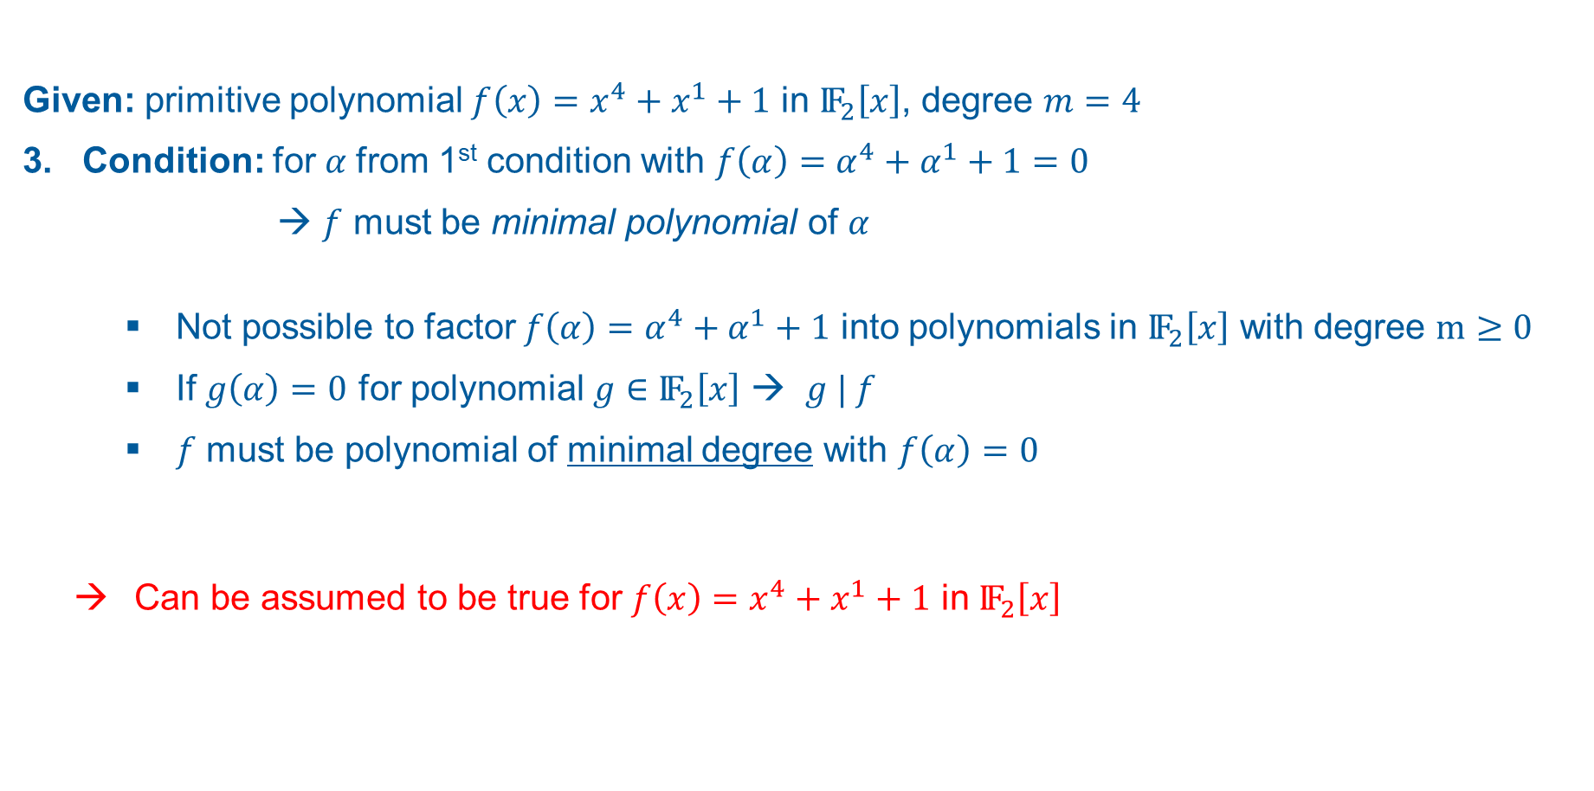
Linear Feedback Shift Registers (LFSRs)
m-sequences: Primitive Polynomials
Given: primitive polynomial $f\left.\left(x\right.\right)=x^{4}+x^{1}+1$ in ${\text{IF}}_{2}\left[x\right]$, degree $m=4$
3. Condition: for 𝛼 from 1st condition with $f\left.\left(α\right.\right)={\text{α}}^{4}+{\text{α}}^{1}+1=0$
→ $f$ must be minimal polynomial of 𝛼
Not possible to factor $f\left.\left(α\right.\right)={\text{α}}^{4}+{\text{α}}^{1}+1$ into polynomials in ${\text{IF}}_{2}\left[x\right]$ with degree $m≥0$
If $g\left.\left(α\right.\right)=0$ for polynomial $g$ $∈$ ${\text{IF}}_{2}\left[x\right]$ → $g | f$
$f$ must be polynomial of minimal degree with $f\left.\left(α\right.\right)=0$
Can be assumed to be true for $f\left.\left(x\right.\right)=x^{4}+x^{1}+1$ in ${\text{IF}}_{2}\left[x\right]$

Slide 13
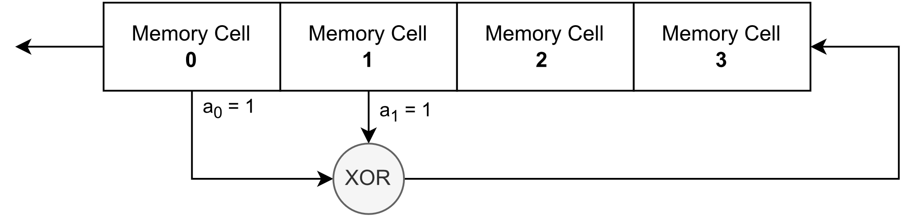
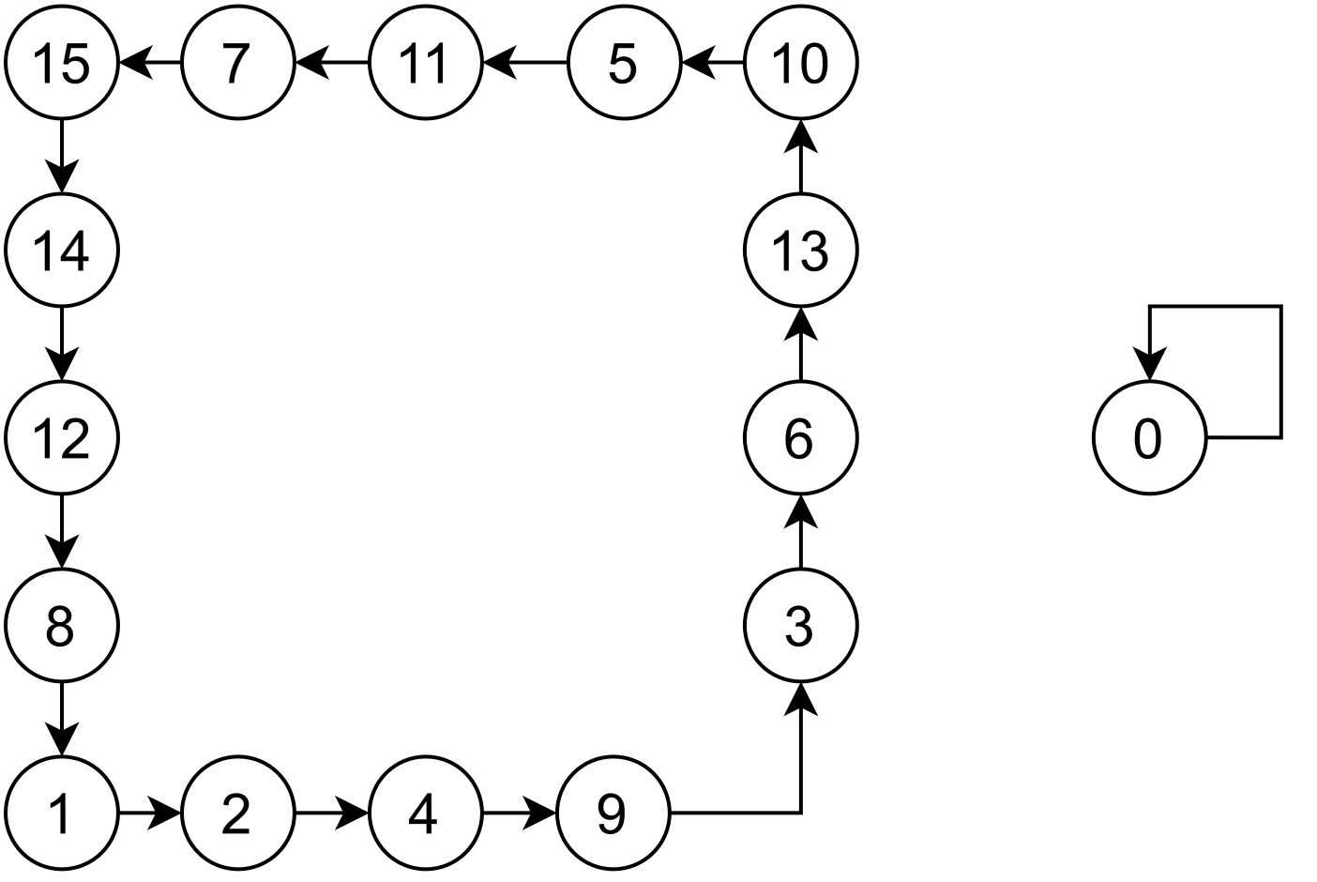
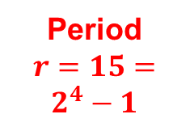
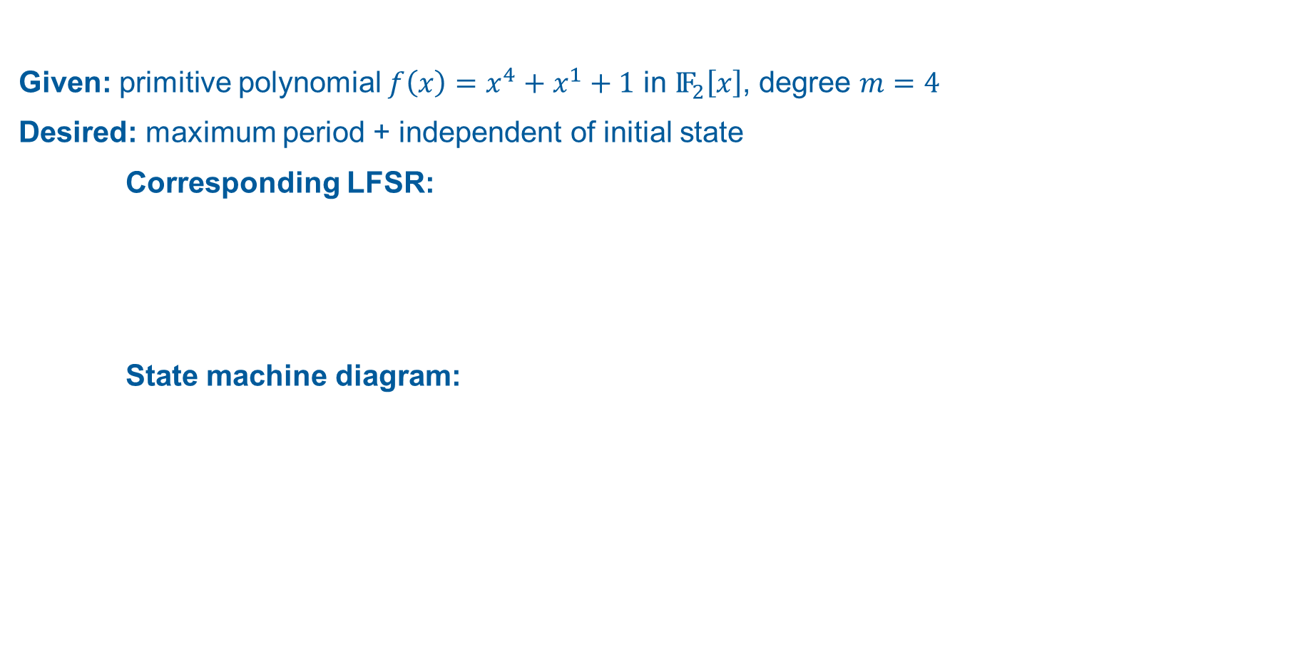
Linear Feedback Shift Registers (LFSRs)
m-sequences: Example
Given: primitive polynomial $f\left.\left(x\right.\right)=x^{4}+x^{1}+1$ in ${\text{IF}}_{2}\left[x\right]$, degree $m=4$
Desired: maximum period + independent of initial state
Corresponding LFSR:
State machine diagram:
Based on: [4, p. 430]
→ Requirements satisfied
Period
$r=15=2^{4}−1$
Based on: [11, pp. 230-232]

Slide 14
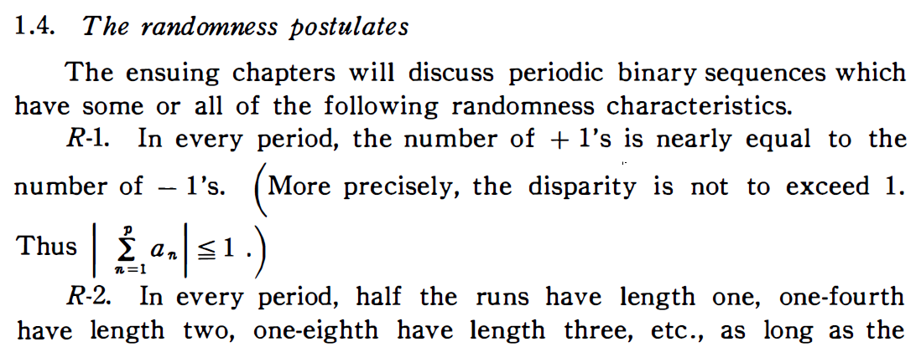
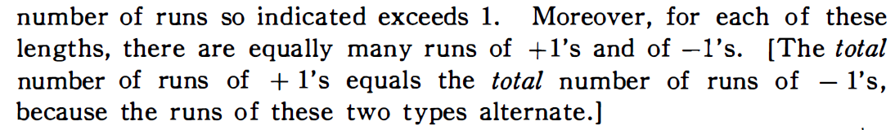
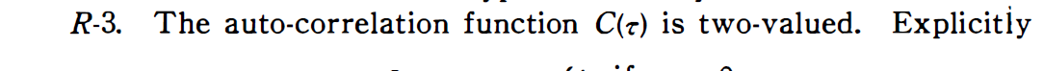


Linear Feedback Shift Registers (LFSRs)
m-sequences: Statistical Properties
1967: Solomon Golomb‘s Randomness Postulates ➔ fulfilled by m-sequences
Number of $1$-bits ≈ Number of $0$-bits
Number of 1-bit sequences = Number of 0-bit sequences
$$\left|11\right|=\left|00\right|$$
$$\left|111\right|=\left|000\right|$$
$$\left|1111\right|=|0000|$$
$$…$$
[8, p. 25]
→ Statistically secure
= cryptographically secure? …

Slide 15
NÄCHSTER ABSCHNITT

Slide 16
Security of Stream Ciphers based on LFSRs
Properties of LFSRs
Efficiently implemented in hardware with shift registers
Encryption of messages with unknown length like audio or video data
Calculation of succeeding bits in advance to allow faster encryption
No error propagation if a bit is faulty
How cryptographically secure are LFSRs?

Slide 17
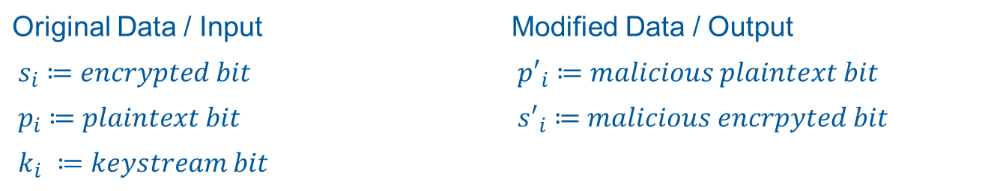

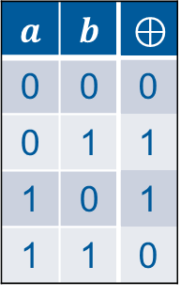
Security of Stream Ciphers based on LFSRs
Known-Plaintext Attack
Adversary knows a part of the plaintext and its location in the encrypted message
The original keystream can be calculated based on this information
Malicious data can be combined with the gained keystream to modify original message
${(s}_{i}⊕p_{i})⊕{p^{′}}_{i}=\left((k_{i}⊕p_{i}\right)⊕p_{i})⊕{p^{′}}_{i}={(k}_{i}⊕0)⊕{p′}_{i}=k_{i}⊕{p′}_{i}=s_{i}′$
Original Data / Input | Modified Data / Output
$${ s}_{i} ≔encrypted bit$$ | $${ p′}_{i} ≔malicious plaintext bit$$
$${ p}_{i} ≔plaintext bit$$ | $${ s′}_{i} ≔malicious encrpyted bit$$
$$k_{i} ≔keystream bit$$
$$a$$ | $$b$$ | $$⊕$$
0 | 0 | 0
0 | 1 | 1
1 | 0 | 1
1 | 1 | 0

Slide 18
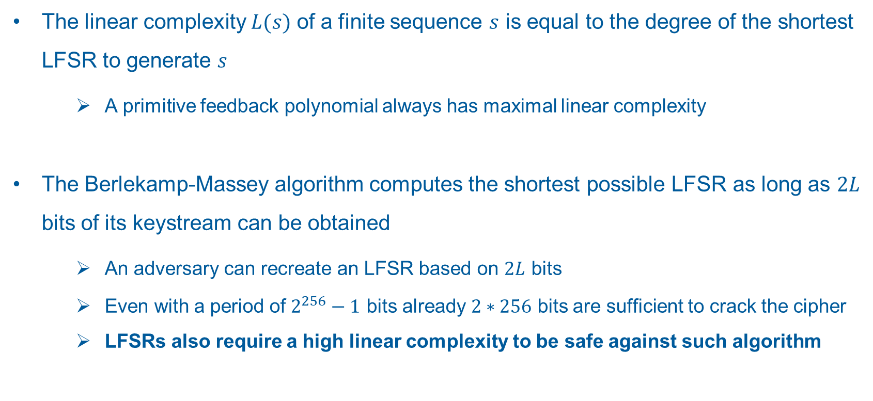
Security of Stream Ciphers based on LFSRs
Linear Complexity and the Berlekamp-Massey Algorithm
The linear complexity $L(s)$ of a finite sequence $s$ is equal to the degree of the shortest LFSR to generate $s$
A primitive feedback polynomial always has maximal linear complexity
The Berlekamp-Massey algorithm computes the shortest possible LFSR as long as $2L$ bits of its keystream can be obtained
An adversary can recreate an LFSR based on $2L$ bits
Even with a period of $2^{256}−1$ bits already $2∗256$ bits are sufficient to crack the cipher
LFSRs also require a high linear complexity to be safe against such algorithm

Slide 19
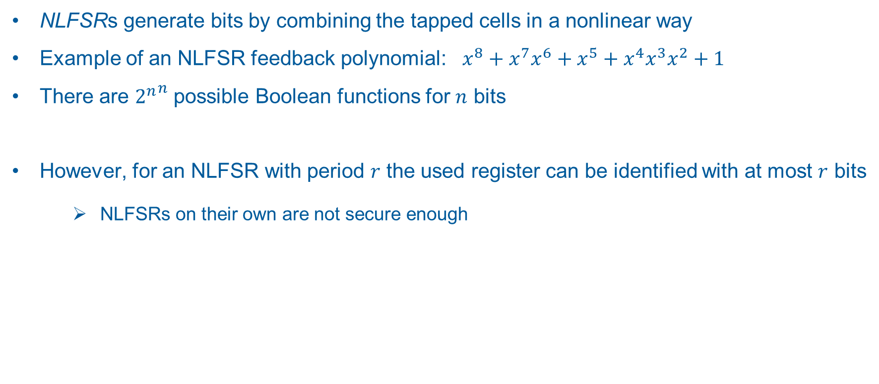
Increasing the Cryptographic Qualities of LFSRs
Nonlinear Feedback Shift Registers (NLFSR)
NLFSRs generate bits by combining the tapped cells in a nonlinear way
Example of an NLFSR feedback polynomial: ${{{x^{8}+x}^{7}x}^{6}+x}^{5}+x^{4}x^{3}x^{2}+1$
There are ${2^{n}}^{n}$ possible Boolean functions for $n$ bits
However, for an NLFSR with period $r$ the used register can be identified with at most $r$ bits
NLFSRs on their own are not secure enough

Slide 20
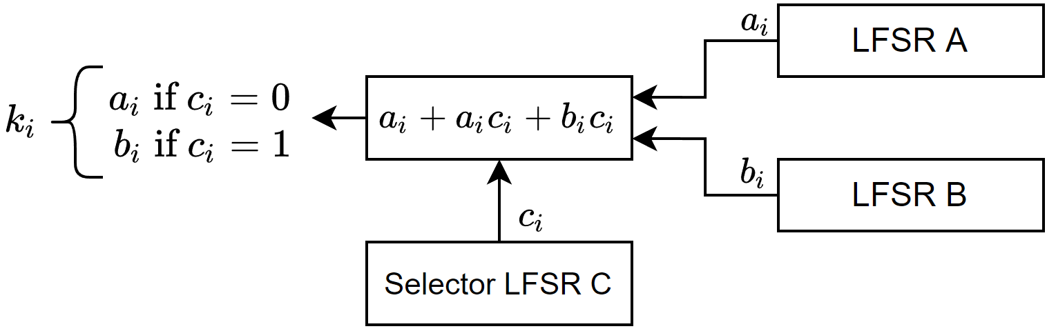
Increasing the Cryptographic Qualities of LFSRs
Combining Linear Feedback Shift Registers with an Output Generator
Combines the output of multiple LFSRs with a nonlinear combination function
The Geffe Generator implements this principle:
Select output from one of two LFSRs based on the bit of another LFSR

Slide 21
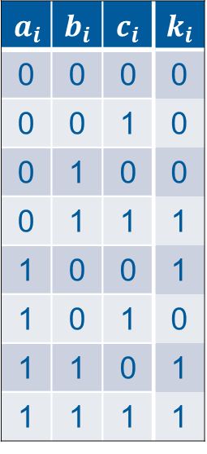
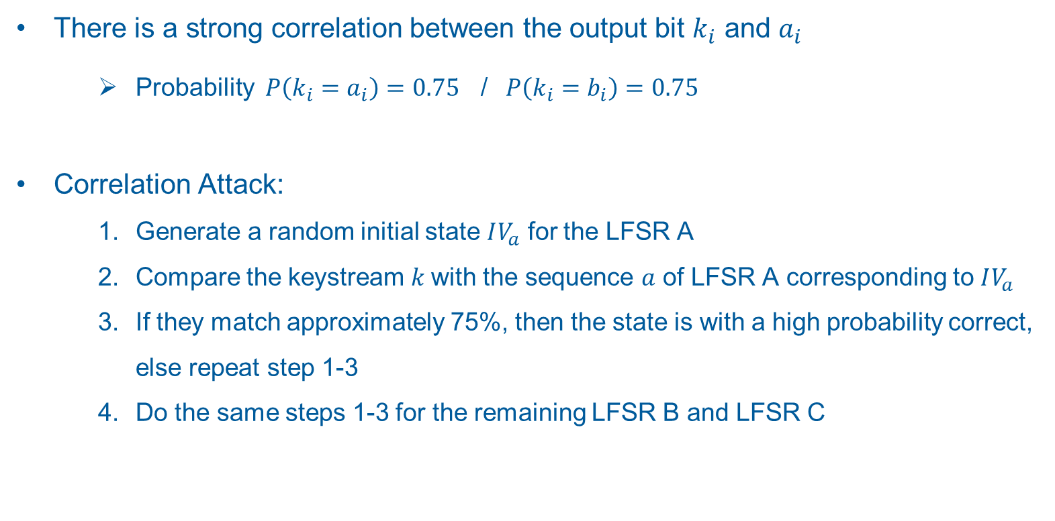
Increasing the Cryptographic Qualities of LFSRs
Correlation Attack on the Geffe Generator
There is a strong correlation between the output bit $k_{i}$ and $a_{i}$
Probability $P\left(k_{i}=a_{i}\right)=0.75$ / $P\left(k_{i}=b_{i}\right)=0.75$
Correlation Attack:
Generate a random initial state $IV_{a}$ for the LFSR A
Compare the keystream $k$with the sequence $a$ of LFSR A corresponding to $IV_{a}$
If they match approximately 75%, then the state is with a high probability correct, else repeat step 1-3
Do the same steps 1-3 for the remaining LFSR B and LFSR C
$$a_{i}$$ | $$b_{i}$$ | $$c_{i}$$ | $$k_{i}$$
0 | 0 | 0 | 0
0 | 0 | 1 | 0
0 | 1 | 0 | 0
0 | 1 | 1 | 1
1 | 0 | 0 | 1
1 | 0 | 1 | 0
1 | 1 | 0 | 1
1 | 1 | 1 | 1

Slide 22
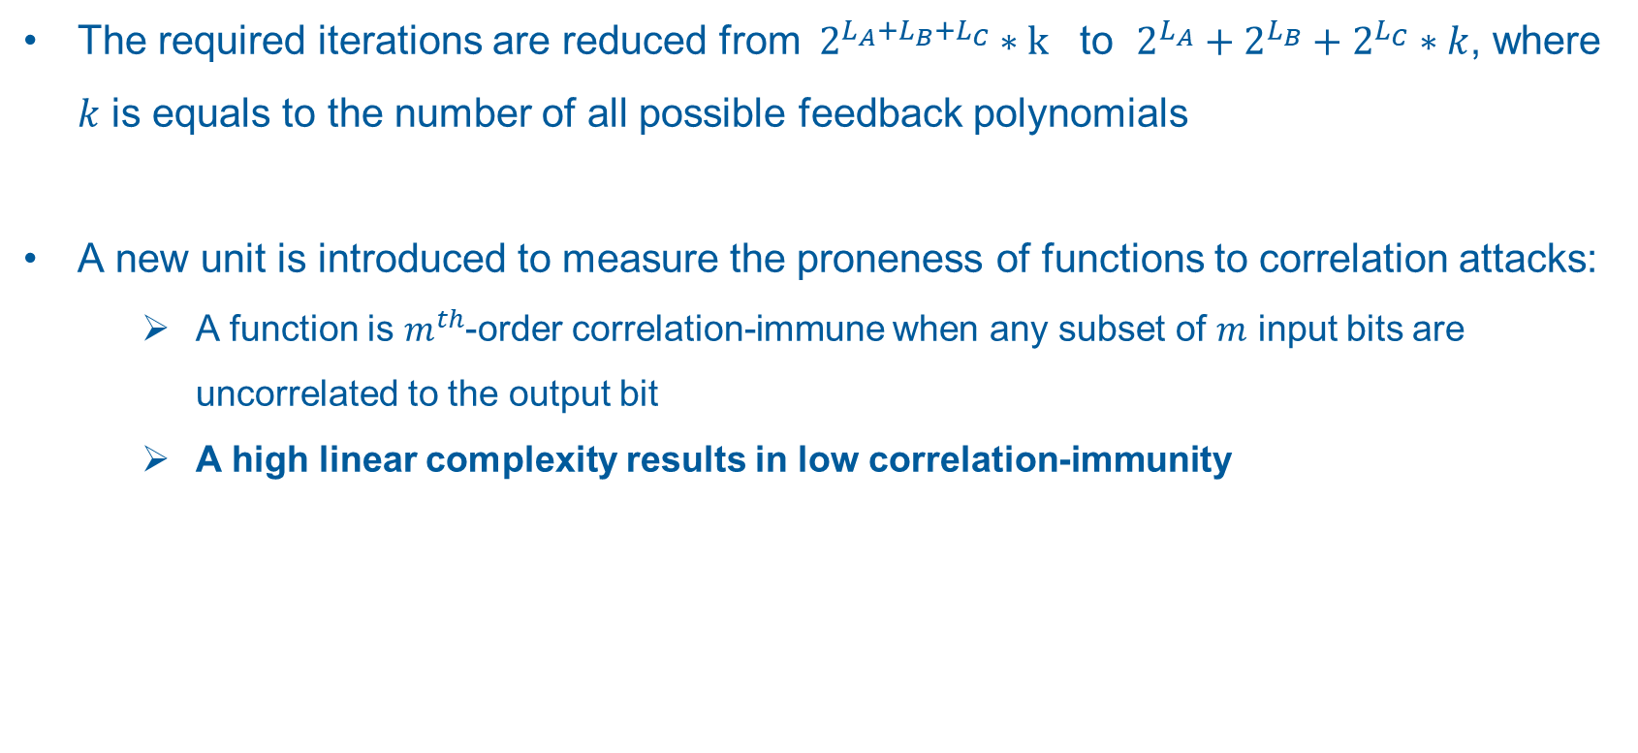
Increasing the Cryptographic Qualities of LFSRs
Correlation Attack on the Geffe Generator
The required iterations are reduced from ${ 2}^{L_{A}+L_{B}+L_{C}} ∗\text{k}$ to $2^{L_{A}}+2^{L_{B}}+2^{L_{C}}∗k$, where $k$ is equals to the number of all possible feedback polynomials
A new unit is introduced to measure the proneness of functions to correlation attacks:
A function is $m^{th}$-order correlation-immune when any subset of $m$ input bits are uncorrelated to the output bit
A high linear complexity results in low correlation-immunity

Slide 23
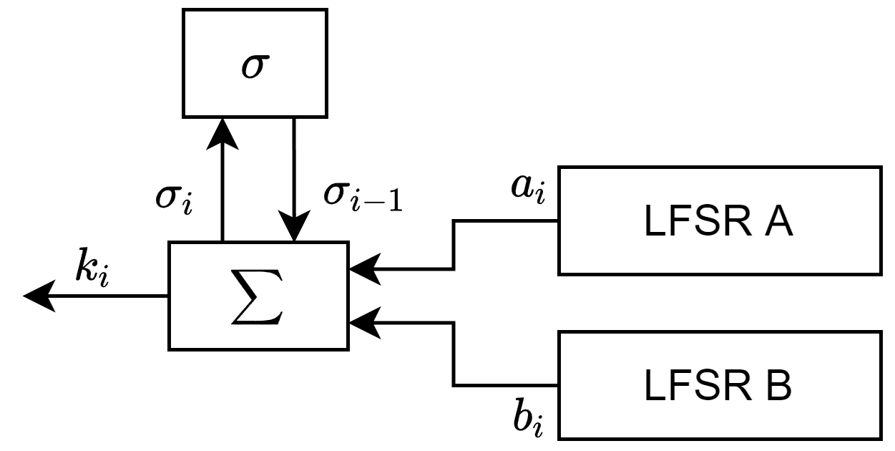
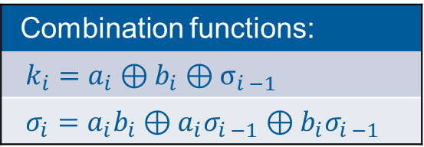
Increasing the Cryptographic Qualities of LFSRs
Extending Nonlinear Output Generators with Memory Cells
To achieve maximum linear complexity and correlation-immunity simultaneously a memory component is added to the generators
The summation combiner uses integer addition with a memory acting as the carry bit σ
Combination functions:
$$k_{i}=a_{i}⊕b_{i}⊕σ_{i −1}$$
$$σ_{i}=a_{i}b_{i}⊕a_{i}σ_{i −1}⊕b_{i}σ_{i −1}$$

Slide 24
Increasing the Cryptographic Qualities of LFSRs
Summary of early attempts to increase the cryptographically security of stream ciphers
Metrics such as the period, linear complexity or correlation-immunity only guarantee minimal security of stream ciphers
The to this point presented stream ciphers are considered unsecure today
To still be able to use stream ciphers in modern encryption methods, more secure approaches are necessary

Slide 25
NÄCHSTER ABSCHNITT

Slide 26
eSTREAM Contest

Slide 27
eSTREAM Contest
Took place between 2004 and 2008
Main goal: finding a stream cipher at least as strong than Advanced Encryption Standard (AES)
34 initial contestants
7 finalists were included in the eSTREAM Portfolio

Slide 28
eSTREAM Contest
Profiles
 | key length (bits) | IV length (bits) | Tag length (bits)
Profile 1 | 128 | 64 and 128 | -
Profile 1A | 128 | 64 and 128 | 32, 64, 96 or 128
Profile 2 | 80 | 32 and 64 | -
Profile 2A | 80 | 32 and 64 | 32 or 64

Slide 29
eSTREAM Contest
Portfolio
Rabbit | 2.80 | Trivium | 4.35
Salsa | 2.80 | Grain v1 | 3.50
SOSEMANUK | 1.20 | MICKEY v2 | 0.17
HC-128 | 0.60

Slide 30
eSTREAM Contest
Portfolio Designs
ARX-based ciphers
Rabbit
Salsa20
NFSR-based ciphers
Trivium
Grain
LFSR-based ciphers
MICKEY v2
SOSEMANUK
Random shuffled
HC-128

Slide 31
Trivium

Slide 32
Trivium
Specifications
IV: 80 bits
Key: 80 bits
Internal State: 288 bits (s₁, …, s₂₈₈)
Key stream: N ≤ 2⁶⁴ (z₁, …, z_{n}), where N is the length of the plaintext.
Stream generation starts after 4*288 cycles

Slide 33

Trivium
Initialization
(s₁, s₂, ..., s₉₃) ← (K₁, ..., K₈₀, 0, ..., 0)
(s₉₄, s₉₅, ..., s₁₇₇) ← (IV₁, ..., IV₈₀, 0, ..., 0)
(s₁₇₈, s₂₇₉, ..., s₂₈₈) ← (0, ..., 0, 1, 1, 1)
for i = 1 to 4 * 288 do
t₁ ← s₆₆ $⊕$s₉₁ $⊙$ s₉₂ $⊕$s₉₃ $⊕$s₁₇₁
t₂ ← s₁₆₂ $⊕$s₁₇₅ $⊙$s₁₇₆ $⊕$s₁₇₇ $⊕$s₂₆₄
t₃ ← s₂₄₃ $⊕$s₂₈₆ $⊙$s₂₈₇ $⊕$s₂₈₈ $⊕$s₆₉
(s₁, s₂, ..., s₉₃) ← (t₃, s₁, ..., s₉₂)
(s₉₄, s₉₅, ..., s₁₇₇) ← (t₁, s₉₄, ..., s₁₇₆)
(s₁₇₈, s₂₇₉, ..., s₂₈₈) ← (t₂, s₁₇₈, ..., s₂₈₇)
end for

Slide 34
Trivium
Stream Generation
for i = 1 to N do
t₁ ← s₆₆ ⊕ s₉₃
t₂ ← s₁₆₂ ⊕ s₁₇₇
t₃ ← s₂₄₃ ⊕ s₂₈₈
z_{i} ← t₁ ⊕ t₂ ⊕ t₃
t₁ ← t₁ ⊕ s₉₁ ⊙ s₉₂ ⊕ _{s171}
t₂ ← t₂ ⊕ s₁₇₅ ⊙ s₁₇₆ ⊕ s₂₆₄
t₃ ← t₃ ⊕ s₂₈₆ ⊙ s₂₈₇ ⊕ s₆₉
(s₁, s₂, ..., s₉₃) ← (t₃, s₁, ..., s₉₂)
(s₉₄, s₉₅, ..., s₁₇₇) ← (t₁, s₉₄, ..., s₁₇₆)
(s₁₇₈, s₂₇₉, ..., s₂₈₈₎ ← (t₂, s₁₇₈, ..., s₂₈₇)
end for

Slide 35
Trivium
Example
plainText = 0110 0001 = ‘a’
IV = 0111 0000 1100 0001 0101 0111 1100 0110 1101 0111 1110 1000 1011 0111 0001 0000 1110 1110 0000 0111
K = 0010 0101 1001 0101 1010 1011 0000 0011 0000 1101 0011 1100 0010 0100 0001 0001 0111 0110 1110 1010
Internal State 288 bits:
regA – 93 bits long
regB – 84 bits long
regC – 111 bits long

Slide 36
Trivium
Example
(s₁, s₂, ..., s₉₃) ← (K₁, ..., K₈₀, 0, ..., 0)
(s₉₄, s₉₅, ..., s₁₇₇) ← (IV₁, ..., IV₈₀, 0, ..., 0)
(s₁₇₈, s₂₇₉, ..., s₂₈₈) ← (0, ..., 0, 1, 1, 1)
regA = 0111 0000 1100 0001 0101 0111 1100 0110 1101 0111 1110 1000 1011 0111 0001 0000 1110 1110 0000 0111 0000 0000 0000 0
regB = 0010 0101 1001 0101 1010 1011 0000 0011 0000 1101 0011 1100 0010 0100 0001 0001 0111 0110 1110 1010 0000
regC = 0000 0000 0000 0000 0000 0000 0000 0000 0000 0000 0000 1000 0000 0000 0000 0000 0000 0000 0000 0000 0000 0000 0000 0000 0000 0000 0000 111

Slide 37
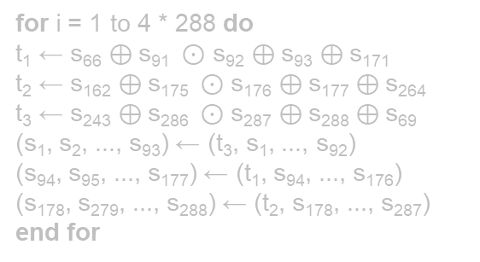

Trivium
for i = 1 to 4 * 288 do
t₁ ← s₆₆ $⊕$s₉₁ $⊙$ s₉₂ $⊕$s₉₃ $⊕$s₁₇₁
t₂ ← s₁₆₂ $⊕$s₁₇₅ $⊙$s₁₇₆ $⊕$s₁₇₇ $⊕$s₂₆₄
t₃ ← s₂₄₃ $⊕$s₂₈₆ $⊙$s₂₈₇ $⊕$s₂₈₈ $⊕$s₆₉
(s₁, s₂, ..., s₉₃) ← (t₃, s₁, ..., s₉₂)
(s₉₄, s₉₅, ..., s₁₇₇) ← (t₁, s₉₄, ..., s₁₇₆)
(s₁₇₈, s₂₇₉, ..., s₂₈₈) ← (t₂, s₁₇₈, ..., s₂₈₇)
end for
Example
regA = 0111 0000 1100 0001 0101 0111 1100 0110 1101 0111 1110 1000 1011 0111 0001 0000 1110 1110 0000 0111 0000 0000 0000 0
regB = 0010 0101 1001 0101 1010 1011 0000 0011 0000 1101 0011 1100 0010 0100 0001 0001 0111 0110 1110 1010 0000
regA₆₆ = 1, regA₉₁ = 0, regA₉₂ = 0, regA₉₃ = 1, regB₇₈ = 1
t₁ = 1 $⊕$ 0 = 1

Slide 38

Trivium
for i = 1 to 4 * 288 do
t₁ ← s₆₆ $⊕$s₉₁ $⊙$ s₉₂ $⊕$s₉₃ $⊕$s₁₇₁
t₂ ← s₁₆₂ $⊕$s₁₇₅ $⊙$s₁₇₆ $⊕$s₁₇₇ $⊕$s₂₆₄
t₃ ← s₂₄₃ $⊕$s₂₈₆ $⊙$s₂₈₇ $⊕$s₂₈₈ $⊕$s₆₉
(s₁, s₂, ..., s₉₃) ← (t₃, s₁, ..., s₉₂)
(s₉₄, s₉₅, ..., s₁₇₇) ← (t₁, s₉₄, ..., s₁₇₆)
(s₁₇₈, s₂₇₉, ..., s₂₈₈) ← (t₂, s₁₇₈, ..., s₂₈₇)
end for
Example
regA = 0111 0000 1100 0001 0101 0111 1100 0110 1101 0111 1110 1000 1011 0111 0001 0000 1110 1110 0000 0111 0000 0000 0000 0
regB = 0010 0101 1001 0101 1010 1011 0000 0011 0000 1101 0011 1100 0010 0100 0001 0001 0111 0110 1110 1010 0000
regA₆₆ = 1, regA₉₁ = 0, regA₉₂ = 0, regA₉₃ = 1, regB₇₈ = 1
t₁ = 1 $⊕$ 0 = 1 -> 1 ⊙ 0 = 1

Slide 39

Trivium
for i = 1 to 4 * 288 do
t₁ ← s₆₆ $⊕$s₉₁ $⊙$ s₉₂ $⊕$s₉₃ $⊕$s₁₇₁
t₂ ← s₁₆₂ $⊕$s₁₇₅ $⊙$s₁₇₆ $⊕$s₁₇₇ $⊕$s₂₆₄
t₃ ← s₂₄₃ $⊕$s₂₈₆ $⊙$s₂₈₇ $⊕$s₂₈₈ $⊕$s₆₉
(s₁, s₂, ..., s₉₃) ← (t₃, s₁, ..., s₉₂)
(s₉₄, s₉₅, ..., s₁₇₇) ← (t₁, s₉₄, ..., s₁₇₆)
(s₁₇₈, s₂₇₉, ..., s₂₈₈) ← (t₂, s₁₇₈, ..., s₂₈₇)
end for
Example
regA = 0111 0000 1100 0001 0101 0111 1100 0110 1101 0111 1110 1000 1011 0111 0001 0000 1110 1110 0000 0111 0000 0000 0000 0
regB = 0010 0101 1001 0101 1010 1011 0000 0011 0000 1101 0011 1100 0010 0100 0001 0001 0111 0110 1110 1010 0000
regA₆₆ = 1, regA₉₁ = 0, regA₉₂ = 0, regA₉₃ = 1, regB₇₈ = 1
t₁ = 1 $⊕$ 0 = 1 -> 1 ⊙ 0 = 1 -> 1 $⊕$ 1 = 0

Slide 40

Trivium
for i = 1 to 4 * 288 do
t₁ ← s₆₆ $⊕$s₉₁ $⊙$ s₉₂ $⊕$s₉₃ $⊕$s₁₇₁
t₂ ← s₁₆₂ $⊕$s₁₇₅ $⊙$s₁₇₆ $⊕$s₁₇₇ $⊕$s₂₆₄
t₃ ← s₂₄₃ $⊕$s₂₈₆ $⊙$s₂₈₇ $⊕$s₂₈₈ $⊕$s₆₉
(s₁, s₂, ..., s₉₃) ← (t₃, s₁, ..., s₉₂)
(s₉₄, s₉₅, ..., s₁₇₇) ← (t₁, s₉₄, ..., s₁₇₆)
(s₁₇₈, s₂₇₉, ..., s₂₈₈) ← (t₂, s₁₇₈, ..., s₂₈₇)
end for
Example
regA = 0111 0000 1100 0001 0101 0111 1100 0110 1101 0111 1110 1000 1011 0111 0001 0000 1110 1110 0000 0111 0000 0000 0000 0
regB = 0010 0101 1001 0101 1010 1011 0000 0011 0000 1101 0011 1100 0010 0100 0001 0001 0111 0110 1110 1010 0000
regA₆₆ = 1, regA₉₁ = 0, regA₉₂ = 0, regA₉₃ = 1, regB₇₈ = 1
t₁ = 1 $⊕$ 0 = 1 -> 1 ⊙ 0 = 1 -> 1 $⊕$ 1 = 0 -> 0 $⊕$ 1

Slide 41

Trivium
for i = 1 to 4 * 288 do
t₁ ← s₆₆ $⊕$s₉₁ $⊙$ s₉₂ $⊕$s₉₃ $⊕$s₁₇₁
t₂ ← s₁₆₂ $⊕$s₁₇₅ $⊙$s₁₇₆ $⊕$s₁₇₇ $⊕$s₂₆₄
t₃ ← s₂₄₃ $⊕$s₂₈₆ $⊙$s₂₈₇ $⊕$s₂₈₈ $⊕$s₆₉
(s₁, s₂, ..., s₉₃) ← (t₃, s₁, ..., s₉₂)
(s₉₄, s₉₅, ..., s₁₇₇) ← (t₁, s₉₄, ..., s₁₇₆)
(s₁₇₈, s₂₇₉, ..., s₂₈₈) ← (t₂, s₁₇₈, ..., s₂₈₇)
end for
Example
regA = 0111 0000 1100 0001 0101 0111 1100 0110 1101 0111 1110 1000 1011 0111 0001 0000 1110 1110 0000 0111 0000 0000 0000 0
regB = 0010 0101 1001 0101 1010 1011 0000 0011 0000 1101 0011 1100 0010 0100 0001 0001 0111 0110 1110 1010 0000
regA₆₆ = 1, regA₉₁ = 0, regA₉₂ = 0, regA₉₃ = 1, regB₇₈ = 1
t₁ = 1 $⊕$ 0 = 1 -> 1 ⊙ 0 = 1 -> 1 $⊕$ 1 = 0 -> 0 $⊕$ 1 = 1

Slide 42
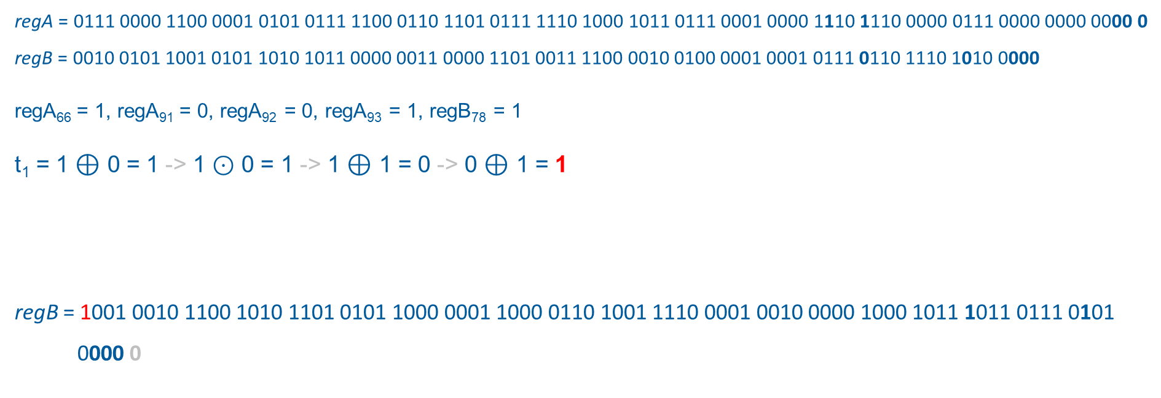
Trivium
for i = 1 to 4 * 288 do
t₁ ← s₆₆ $⊕$s₉₁ $⊙$ s₉₂ $⊕$s₉₃ $⊕$s₁₇₁
t₂ ← s₁₆₂ $⊕$s₁₇₅ $⊙$s₁₇₆ $⊕$s₁₇₇ $⊕$s₂₆₄
t₃ ← s₂₄₃ $⊕$s₂₈₆ $⊙$s₂₈₇ $⊕$s₂₈₈ $⊕$s₆₉
(s₁, s₂, ..., s₉₃) ← (t₃, s₁, ..., s₉₂)
(s₉₄, s₉₅, ..., s₁₇₇) ← (t₁, s₉₄, ..., s₁₇₆)
(s₁₇₈, s₂₇₉, ..., s₂₈₈) ← (t₂, s₁₇₈, ..., s₂₈₇)
end for
Example
regA = 0111 0000 1100 0001 0101 0111 1100 0110 1101 0111 1110 1000 1011 0111 0001 0000 1110 1110 0000 0111 0000 0000 0000 0
regB = 0010 0101 1001 0101 1010 1011 0000 0011 0000 1101 0011 1100 0010 0100 0001 0001 0111 0110 1110 1010 0000
regA₆₆ = 1, regA₉₁ = 0, regA₉₂ = 0, regA₉₃ = 1, regB₇₈ = 1
t₁ = 1 $⊕$ 0 = 1 -> 1 ⊙ 0 = 1 -> 1 $⊕$ 1 = 0 -> 0 $⊕$ 1 = 1
regB = 1001 0010 1100 1010 1101 0101 1000 0001 1000 0110 1001 1110 0001 0010 0000 1000 1011 1011 0111 0101 0000 0

Slide 43
Trivium
Example: Initialization
regA = 1101 0111 1001 1001 0110 0111 0001 0010 1010 1000 0101 1000 1010 1011 1111 1100 0110 1011 1001 0110 1100 1110 0100 1
regB = 1101 1101 1101 0101 0111 0101 0011 1110 0001 0101 0011 1000 0011 0001 0111 0111 0011 0011 1001 1110 1100
regC = 1111 0011 0000 0111 1001 0110 0101 0001 0100 0010 1011 1100 0000 0000 0011 1110 0110 0001 1010 1000 1101 0111 0011 1010 1001 1000 1000 0101 0111 0111 0011 0011 1001 1110 1100

Slide 44
Trivium
Stream Generation
keyStream =
for i = 1 to N do
t₁ ← s₆₆ ⊕ s₉₃
t₂ ← s₁₆₂ ⊕ s₁₇₇
t₃ ← s₂₄₃ ⊕ s₂₈₈
z_{i} ← t₁ ⊕ t₂ ⊕ t₃
t₁ ← t₁ ⊕ s₉₁ ⊙ s₉₂ ⊕ _{s171}
t₂ ← t₂ ⊕ s₁₇₅ ⊙ s₁₇₆ ⊕ s₂₆₄
t₃ ← t₃ ⊕ s₂₈₆ ⊙ s₂₈₇ ⊕ s₆₉
(s₁, s₂, ..., s₉₃) ← (t₃, s₁, ..., s₉₂)
(s₉₄, s₉₅, ..., s₁₇₇) ← (t₁, s₉₄, ..., s₁₇₆)
(s₁₇₈, s₂₇₉, ..., s₂₈₈₎ ← (t₂, s₁₇₈, ..., s₂₈₇)
end for

Slide 45
Trivium
Stream Generation
keyStream = 0
for i = 1 to N do
t₁ ← s₆₆ ⊕ s₉₃
t₂ ← s₁₆₂ ⊕ s₁₇₇
t₃ ← s₂₄₃ ⊕ s₂₈₈
z_{i} ← t₁ ⊕ t₂ ⊕ t₃
t₁ ← t₁ ⊕ s₉₁ ⊙ s₉₂ ⊕ _{s171}
t₂ ← t₂ ⊕ s₁₇₅ ⊙ s₁₇₆ ⊕ s₂₆₄
t₃ ← t₃ ⊕ s₂₈₆ ⊙ s₂₈₇ ⊕ s₆₉
(s₁, s₂, ..., s₉₃) ← (t₃, s₁, ..., s₉₂)
(s₉₄, s₉₅, ..., s₁₇₇) ← (t₁, s₉₄, ..., s₁₇₆)
(s₁₇₈, s₂₇₉, ..., s₂₈₈₎ ← (t₂, s₁₇₈, ..., s₂₈₇)
end for
t₁ = 1 ⊕ 1 = 0 t₂ = 0 ⊕ 0 = 0 t₃ = 1 ⊕ 1 = 0

Slide 46
Trivium
Stream Generation
keyStream = 01
for i = 1 to N do
t₁ ← s₆₆ ⊕ s₉₃
t₂ ← s₁₆₂ ⊕ s₁₇₇
t₃ ← s₂₄₃ ⊕ s₂₈₈
z_{i} ← t₁ ⊕ t₂ ⊕ t₃
t₁ ← t₁ ⊕ s₉₁ ⊙ s₉₂ ⊕ _{s171}
t₂ ← t₂ ⊕ s₁₇₅ ⊙ s₁₇₆ ⊕ s₂₆₄
t₃ ← t₃ ⊕ s₂₈₆ ⊙ s₂₈₇ ⊕ s₆₉
(s₁, s₂, ..., s₉₃) ← (t₃, s₁, ..., s₉₂)
(s₉₄, s₉₅, ..., s₁₇₇) ← (t₁, s₉₄, ..., s₁₇₆)
(s₁₇₈, s₂₇₉, ..., s₂₈₈₎ ← (t₂, s₁₇₈, ..., s₂₈₇)
end for
t₁ = 1 ⊕ 1 = 0 t₂ = 0 ⊕ 0 = 0 t₃ = 1 ⊕ 1 = 0
t₁ = 0 ⊕ 0 = 0 t₂ = 1 ⊕ 0 = 1 t₃ = 0 ⊕ 0 = 0

Slide 47
Trivium
Stream Generation
keyStream = 010
for i = 1 to N do
t₁ ← s₆₆ ⊕ s₉₃
t₂ ← s₁₆₂ ⊕ s₁₇₇
t₃ ← s₂₄₃ ⊕ s₂₈₈
z_{i} ← t₁ ⊕ t₂ ⊕ t₃
t₁ ← t₁ ⊕ s₉₁ ⊙ s₉₂ ⊕ _{s171}
t₂ ← t₂ ⊕ s₁₇₅ ⊙ s₁₇₆ ⊕ s₂₆₄
t₃ ← t₃ ⊕ s₂₈₆ ⊙ s₂₈₇ ⊕ s₆₉
(s₁, s₂, ..., s₉₃) ← (t₃, s₁, ..., s₉₂)
(s₉₄, s₉₅, ..., s₁₇₇) ← (t₁, s₉₄, ..., s₁₇₆)
(s₁₇₈, s₂₇₉, ..., s₂₈₈₎ ← (t₂, s₁₇₈, ..., s₂₈₇)
end for
t₁ = 1 ⊕ 1 = 0 t₂ = 0 ⊕ 0 = 0 t₃ = 1 ⊕ 1 = 0
t₁ = 0 ⊕ 0 = 0 t₂ = 1 ⊕ 0 = 1 t₃ = 0 ⊕ 0 = 0
t₁ = 0 ⊕ 0 = 0 t₂ = 1 ⊕ 1 = 0 t₃ = 0 ⊕ 0 = 0

Slide 48
Trivium
Stream Generation
keyStream = 0101
for i = 1 to N do
t₁ ← s₆₆ ⊕ s₉₃
t₂ ← s₁₆₂ ⊕ s₁₇₇
t₃ ← s₂₄₃ ⊕ s₂₈₈
z_{i} ← t₁ ⊕ t₂ ⊕ t₃
t₁ ← t₁ ⊕ s₉₁ ⊙ s₉₂ ⊕ _{s171}
t₂ ← t₂ ⊕ s₁₇₅ ⊙ s₁₇₆ ⊕ s₂₆₄
t₃ ← t₃ ⊕ s₂₈₆ ⊙ s₂₈₇ ⊕ s₆₉
(s₁, s₂, ..., s₉₃) ← (t₃, s₁, ..., s₉₂)
(s₉₄, s₉₅, ..., s₁₇₇) ← (t₁, s₉₄, ..., s₁₇₆)
(s₁₇₈, s₂₇₉, ..., s₂₈₈₎ ← (t₂, s₁₇₈, ..., s₂₈₇)
end for
t₁ = 1 ⊕ 1 = 0 t₂ = 0 ⊕ 0 = 0 t₃ = 1 ⊕ 1 = 0
t₁ = 0 ⊕ 0 = 0 t₂ = 1 ⊕ 0 = 1 t₃ = 0 ⊕ 0 = 0
t₁ = 0 ⊕ 0 = 0 t₂ = 1 ⊕ 1 = 0 t₃ = 0 ⊕ 0 = 0
t₁ = 0 ⊕ 1 = 1 t₂ = 1 ⊕ 1 = 0 t₃ = 0 ⊕ 0 = 0

Slide 49
Trivium
Stream Generation
keyStream = 0101 0111 = 6
for i = 1 to N do
t₁ ← s₆₆ ⊕ s₉₃
t₂ ← s₁₆₂ ⊕ s₁₇₇
t₃ ← s₂₄₃ ⊕ s₂₈₈
z_{i} ← t₁ ⊕ t₂ ⊕ t₃
t₁ ← t₁ ⊕ s₉₁ ⊙ s₉₂ ⊕ _{s171}
t₂ ← t₂ ⊕ s₁₇₅ ⊙ s₁₇₆ ⊕ s₂₆₄
t₃ ← t₃ ⊕ s₂₈₆ ⊙ s₂₈₇ ⊕ s₆₉
(s₁, s₂, ..., s₉₃) ← (t₃, s₁, ..., s₉₂)
(s₉₄, s₉₅, ..., s₁₇₇) ← (t₁, s₉₄, ..., s₁₇₆)
(s₁₇₈, s₂₇₉, ..., s₂₈₈₎ ← (t₂, s₁₇₈, ..., s₂₈₇)
end for
t₁ = 1 ⊕ 1 = 0 t₂ = 0 ⊕ 0 = 0 t₃ = 1 ⊕ 1 = 0
t₁ = 0 ⊕ 0 = 0 t₂ = 1 ⊕ 0 = 1 t₃ = 0 ⊕ 0 = 0
t₁ = 0 ⊕ 0 = 0 t₂ = 1 ⊕ 1 = 0 t₃ = 0 ⊕ 0 = 0
t₁ = 0 ⊕ 1 = 1 t₂ = 1 ⊕ 1 = 0 t₃ = 0 ⊕ 0 = 0
t₁ = 1 ⊕ 0 = 1 t₂ = 0 ⊕ 0 = 0 t₃ = 1 ⊕ 0 = 1
t₁ = 1 ⊕ 0 = 1 t₂ = 1 ⊕ 1 = 0 t₃ = 1 ⊕ 1 = 0
t₁ = 1 ⊕ 1 = 0 t₂ = 1 ⊕ 1 = 0 t₃ = 1 ⊕ 0 = 1
t₁ = 1 ⊕ 1 = 0 t₂ = 1 ⊕ 1 = 0 t₃ = 1 ⊕ 0 = 1

Slide 50
Trivium
Encryption / Decryption
Encryption:
encryptedText = keyStream ⊕ plainText

Slide 51
Trivium
Encryption / Decryption
Encryption:
encryptedText = keyStream ⊕ plainText
0101 0111 ⊕ 0110 0001

Slide 52
Trivium
Encryption / Decryption
Encryption:
encryptedText = keyStream ⊕ plainText
0101 0111 ⊕ 0110 0001 = 0011 0110 = 6

Slide 53
Trivium
Encryption / Decryption
Encryption:
encryptedText = keyStream ⊕ plainText
0101 0111 ⊕ 0110 0001 = 0011 0110 = 6
Decryption:
plainText = keyStream ⊕ encryptedText

Slide 54
Trivium
Encryption / Decryption
Encryption:
encryptedText = keyStream ⊕ plainText
0101 0111 ⊕ 0110 0001 = 0011 0110 = 6
Decryption:
plainText = keyStream ⊕ encryptedText
0101 0111 ⊕ 0011 0110

Slide 55
Trivium
Encryption / Decryption
Encryption:
encryptedText = keyStream ⊕ plainText
0101 0111 ⊕ 0110 0001 = 0011 0110 = 6
Decryption:
plainText = keyStream ⊕ encryptedText
0101 0111 ⊕ 0011 0110 = 0110 0001 = ‘a’

Slide 56
Conclusions

Slide 57
Conclusion
Single
LFSR
Berlekamp Massey
Non-linear
Combination
of LFSRs
e.g. Correlation Attacks
Stream Cipher
Random Number
eSTREAM
Contest
… Future Attacks?
Rabbit
…
Trivium
“[…] state of sin”
[2, p. 36]

Slide 58
Thank you for your attention!

Slide 59
Literature (1/3)
[1] B. Y. Zhang and G. Gong, “Randomness properties of stream ciphers for wireless communications,”
The Sixth International Workshop on Signal Design and Its Applications in Communications,
pp. 107–109, 2014. DOI: 10.1109/IWSDA.2013.6849074.
[2] J. von Neumann, “Various techniques used in connection with random digits,” in Monte Carlo
Method, ser. National Bureau of Standards Applied Mathematics Series, A. S. Householder,
G. E. Forsythe, and H. H. Germond, Eds., vol. 12, Washington, DC: US Government Printing
Office, 1951, ch. 13, pp. 36–38.
[3] A. J. Menezes, P. C. van Oorschot, and S. A. Vanstone, Handbook of applied cryptography
(CRC Press series on discrete mathematics and its applications), rev. reprint with updates, 5.
printing. Boca Raton: CRC Press, 2001, ISBN: 0-8493-8523-7.
[4] B. Schneier, Angewandte Kryptographie: Protokolle, Algorithmen und Sourcecode in C, 2nd
edition. München: Pearson Studium, 2006, ISBN: 3-8273-7228-3.
[5] K. Schmeh, Kryptografie: Verfahren, Protokolle, Infrastrukturen, 6th edition. Heidelberg: dpunkt.verlag,
2016, ISBN: 978-3-86490-356-4.
[6] A. Beutelspacher, H. B. Neumann, and T. Schwarzpaul, Kryptografie in Theorie und Praxis:
Mathematische Grundlagen für elektronisches Geld, Internetsicherheit und Mobilfunk, 1st edition.
Wiesbaden: Vieweg+Teubner Verlag, 2005, ISBN: 3-528-03168-9. DOI: 10.1007/978-
3-322-93902-9.
[7] W. Ertel and E. Löhmann, Angewandte Kryptographie, 6th edition. München: Hanser, 2020,
ISBN: 978-3-446-46353-0.
[8] S. W. Golomb, Shift register sequences: Secure and limited-access code generators, efficiency
code generators, prescribed property generators, mathematical models, 1st edition.
San Francisco: Holden-Day, Inc., 1967.
[9] M. Stamp and R. M. Low, Applied cryptanalysis: Breaking ciphers in the real world, 1st edition.
Hoboken, New Jersey: Wiley-Interscience a John Wiley & Sons Inc., 2007, ISBN: 978-0-
470-1-1486-5.
[10] R. Lidl and H. Niederreiter, Introduction to finite fields and their applications, 1st edition.
Cambridge: Cambridge University Press, 1986, ISBN: 0-521-30706-6.
[11] N. P. Smart, Cryptography made simple (Information security and cryptography), 1st edition.
Cham et al.: Springer, 2016, ISBN: 978-3-319-21936-3.
[12] R. A. Rueppel, Analysis and Design of Stream Ciphers (Communications and Control Engineering
Series), 1st edition. Berlin and Heidelberg: Springer, 1986, ISBN: 978-3-642-82865-2.
DOI: 10.1007/978-3-642-82865-2.
[13] R. Lidl and H. Niederreiter, Finite fields, 2nd edition. Cambridge: Cambridge University Press,
1997, ISBN: 978-0-521-06567-2. DOI: 10.1017/CBO9780511525926.
[14] G. Gong, T. Helleseth, and P. V. Kumar, “Solomon w. golomb—mathematician, engineer, and
pioneer,” IEEE Transactions on Information Theory, vol. 64, no. 4, pp. 2844–2857, 2018, ISSN: 0018-9448. DOI: 10.1109/TIT.2018.2809497.
[15] M. J. Robshaw, “Stream ciphers,” RSA Labratories, vol. 25, 1995. [Online]. Available: http://www.networkdls.com/Articles/tr-701.pdf (visited on 04/29/2022).

Slide 60
Literature (2/3)
[16] K. Pommerening, Cryptology part iv: Bitstream ciphers, 2000. [Online]. Available: https:
//www.staff.uni-mainz.de/pommeren/Cryptology/Bitstream/ (visited on 05/13/2022).
[17] C. Eckert, IT-Sicherheit: Konzepte - Verfahren - Protokolle, 10th edition. Berlin/Boston: De
Gruyter, 2018, ISBN: 978-3-11-055158-7. DOI: 10.1515/9783110563900.
[18] T. W. Cusick and P. Stanica, Cryptographic Boolean functions and applications, 1st ed. Amsterdam
and Boston: Academic Press/Elsevier, 2009, ISBN: 978-0-08-095222-2. [Online]. Available:
http://site.ebrary.com/lib/alltitles/docDetail.action?docID=10286068.
[19] J. Massey, “Shift-register synthesis and bch decoding,” IEEE Transactions on Information Theory,
vol. 15, no. 1, pp. 122–127, 1969, ISSN: 0018-9448. DOI: 10.1109/TIT.1969. 1054260.
[20] K. Pommerening, “Cryptanalysis of nonlinear feedback shift registers,” Cryptologia, vol. 40,
no. 4, pp. 303–315, 2015, ISSN: 0161-1194. DOI: 10.1080/01611194.2015.1055385.
(visited on 05/13/2022).
[21] F. Handayani and N. P. R. Adiati, “Analysis of geffe generator lfsr properties on the application
of algebraic attack,” ser. AIP Conference Proceedings, AIP Publishing, 2019, p. 020 029. DOI:
10.1063/1.5132456.
[22] T. Siegenthaler, “Correlation-immunity of nonlinear combining functions for cryptographic
applications (corresp.),” IEEE Transactions on Information Theory, vol. 30, no. 5, pp. 776–
780, 1984, ISSN: 0018-9448. DOI: 10.1109/TIT.1984.1056949.
[23] H.Wu, “Cryptanalysis and design of stream ciphers,” Ph.D. dissertation, 2008. [Online]. Available:
https://www.esat.kuleuven.be/cosic/publications/thesis-167.pdf (visited on 04/25/2022).
[24] R. A. Rueppel, “Correlation immunity and the summation generator,” in Advances in Cryptology
— CRYPTO ’85 Proceedings, ser. Lecture Notes in Computer Science, H. C. Williams,
Ed., vol. 218, Berlin, Heidelberg: Springer Berlin Heidelberg, 1986, pp. 260–272, ISBN: 978-
3-540-16463-0. DOI: 10.1007/3- 540- 39799- X_20. [Online]. Available: https:
//link.springer.com/content/pdf/10.1007/3-540-39799-X_20.pdf (visited on 05/15/2022).
[25] W. Meier and O. Staffelbach, “Correlation properties of combiners with memory in stream
ciphers,” Journal of Cryptology, vol. 5, no. 1, pp. 67–86, 1992, ISSN: 0933-2790. DOI: 10.
1007/BF00191322.
[26] T. Beth and F. C. Piper, “The stop-and-go-generator,” in Advances in Cryptology, ser. Lecture
Notes in Computer Science, T. Beth, N. Cot, and I. Ingemarsson, Eds., vol. 209, Berlin, Heidelberg: Springer Berlin Heidelberg, 1985, pp. 88–92, ISBN: 978-3-540-16076-2. DOI: 10.1007/3-540-39757-4_9.
[27] A. Klein, Stream ciphers. London: Springer, 2013, ISBN: 9781447150787.
[28] D. Coppersmith, H. Krawczyk, and Y. Mansour, “The shrinking generator,” in Annual International
Cryptology Conference, Springer, 1993, pp. 22–39.
[29] M. Robshaw, “The estream project,” in New Stream Cipher Designs, Springer, 2008, pp. 1–6.

Slide 61
Literature (3/3)
[30] C. D. Cannière, “Estream software performance,” in New Stream Cipher Designs, Springer,
2008, pp. 119–139.
[31] T. Good and M. Benaissa, “Asic hardware performance,” in New stream cipher designs, Springer,
2008, pp. 267–293.
[32] L. Jiao, Y. Hao, and D. Feng, “Stream cipher designs: A review,” Science China Information
Sciences, vol. 63, no. 3, pp. 1–25, 2020.
[33] M. Boesgaard, M. Vesterager, and E. Zenner, “The rabbit stream cipher,” in New stream cipher
designs, Springer, 2008, pp. 69–83.
[34] D. J. Bernstein, “The salsa20 family of stream ciphers,” in New stream cipher designs, Springer,
2008, pp. 84–97.
[35] C. D. Canni`ere and B. Preneel, “Trivium,” in New stream cipher designs, Springer, 2008,
pp. 244–266.
[36] M. Hell, T. Johansson, and W. Meier, “Grain: A stream cipher for constrained environments,”
International journal of wireless and mobile computing, vol. 2, no. 1, pp. 86–93, 2007.
[37] Ö. Kücük, “Slide resynchronization attack on the initialization of grain 1.0,” eSTREAM, ECRYPT Stream Cipher Project, Report, vol. 44, p. 2006, 2006.
[38] S. Babbage and M. Dodd, “The stream cipher mickey 2.0,” ECRYPT Stream Cipher, pp. 191–
209, 2006.
[39] S. Banik, S. Maitra, and S. Sarkar, “Improved differential fault attack on mickey 2.0,” Journal
of Cryptographic Engineering, vol. 5, no. 1, pp. 13–29, 2015.
[40] C. Berbain, O. Billet, A. Canteaut, et al., “Sosemanuk, a fast software-oriented stream cipher,”
in New stream cipher designs, Springer, 2008, pp. 98–118.
[41] Y. Tsunoo, T. Saito, M. Shigeri, et al., “Evaluation of sosemanuk with regard to guess- and determine attacks,” SASC 2006 Stream Ciphers Revisited, p. 25, 2006.
[42] J.-K. Lee, D. H. Lee, and S. Park, “Cryptanalysis of sosemanuk and snow 2.0 using linear
masks,” in International Conference on the Theory and Application of Cryptology and Information Security, Springer, 2008, pp. 524–538.
[43] H. Wu, “The stream cipher hc-128,” in New stream cipher designs, Springer, 2008, pp. 39–47.
[44] P.-A. Fouque and T. Vannet, “Improving key recovery to 784 and 799 rounds of trivium using
optimized cube attacks,” in International Workshop on Fast Software Encryption, Springer,
2013, pp. 502–517.
[45] F. E. Potestad-Orónez, M. Valencia-Barrero, C. Baena-Oliva, P. Parra-Fern´andez, and C. J.
Jiménez-Fernández, “Breaking trivium stream cipher implemented in asic using experimental attacks and dfa,” Sensors, vol. 20, no. 23, p. 6909, 2020.

